Slide 1
Project Plan
Christian M. Adriano
christian.adriano@hpi.de

Slide 2
Scope

Slide 3

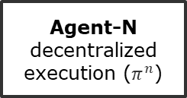
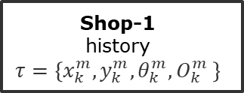
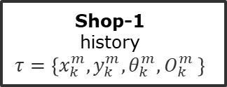


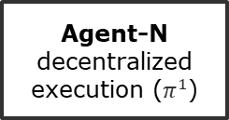

Scenario – Multi-Agent Reinforcement Learning
Trainer
centralized cooperation
Agent-N
decentralized execution ($π_{ }^{1}$)
Agent-N
decentralized execution ($π_{ }^{n}$)
Observation $O^{m}$
Reward $R_{k}$
Action $A^{m}$
Observation $O^{m}$
Reward $R_{k}$
Action $A^{m}$
Shop-1
history
$$τ=\left\{x_{k}^{m},y_{k}^{m}, θ_{k}^{m}, O_{k}^{m} \right\}$$
…
Shop-1
history
$$τ=\left\{x_{k}^{m},y_{k}^{m}, θ_{k}^{m}, O_{k}^{m} \right\}$$
mRubis
failure propagation model (FPM)
failure injection model (FIM)

Slide 4
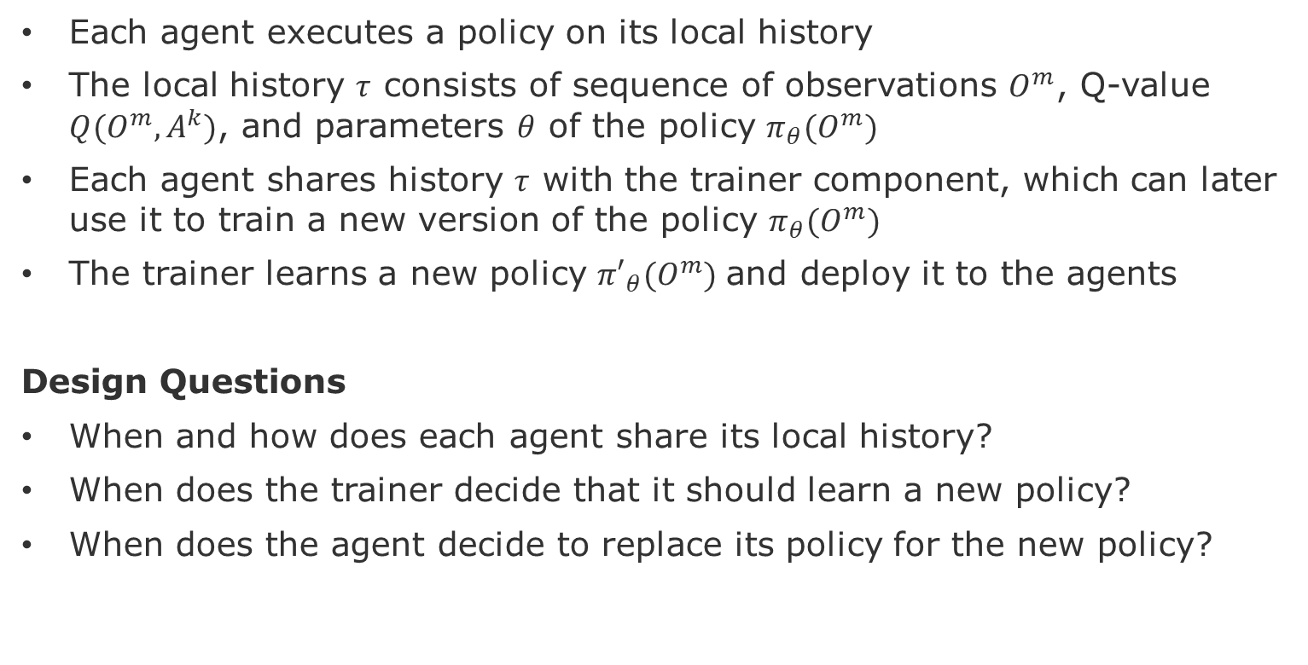
Definition – Agents e Trainer
Each agent executes a policy on its local history
The local history $τ$ consists of sequence of observations $O^{m}$, Q-value $Q(O^{m},A^{k})$, and parameters $θ$ of the policy $π_{θ}(O^{m})$
Each agent shares history $τ$ with the trainer component, which can later use it to train a new version of the policy $π_{θ}(O^{m})$
The trainer learns a new policy ${π′}_{θ}(O^{m})$and deploy it to the agents
Design Questions
When and how does each agent share its local history?
When does the trainer decide that it should learn a new policy?
When does the agent decide to replace its policy for the new policy?

Slide 5
Definitions – Shops and Components
A shop consists of components (18), which have specific responsibilities and present interdependencies (directed). Components can have multiple instances to support surges in demand.
The utility of a shop consists of the sum of the utility of its components. The utility of a component is a function of its parameters.
The parameters of a component consist of:
Shops work in isolation and do not interfere with the operation of other shops.

Slide 6
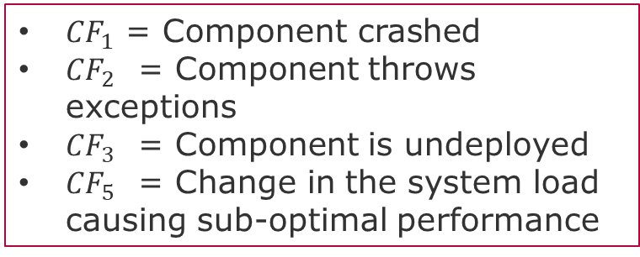
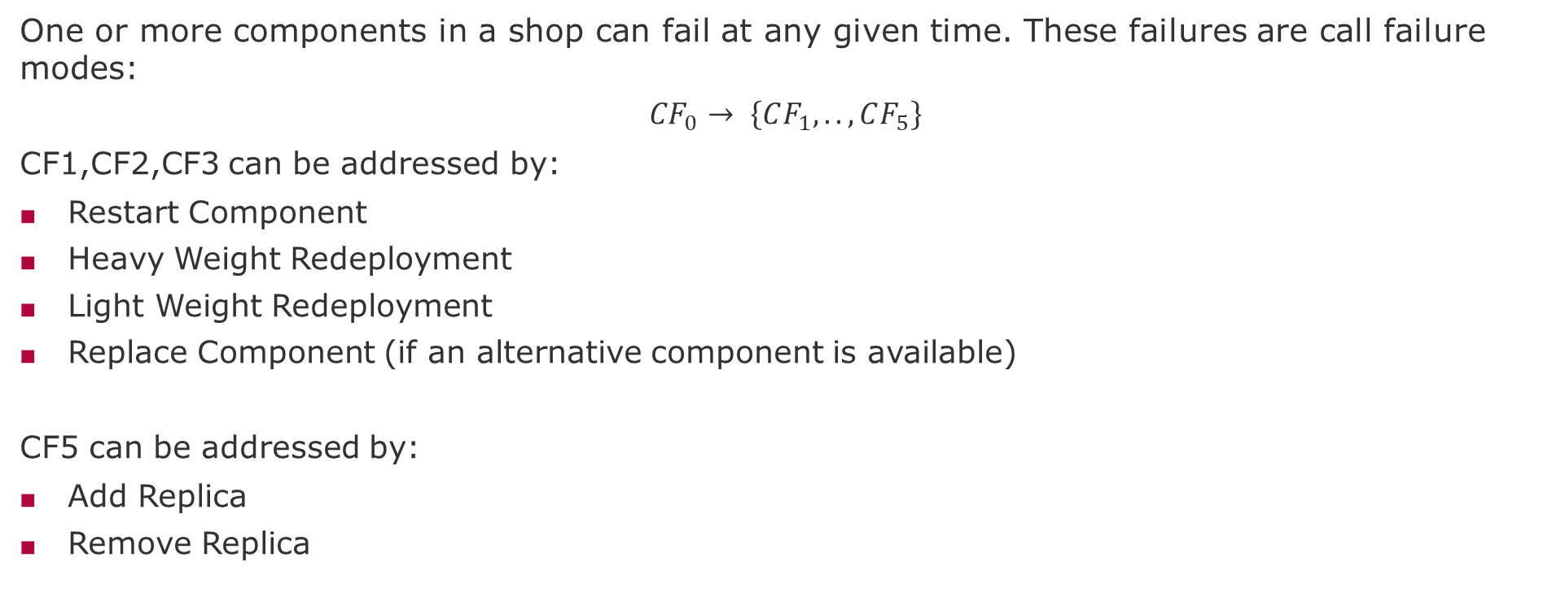
Definitions – Failures and Actions
One or more components in a shop can fail at any given time. These failures are call failure modes:
$${CF}_{0}→ \left\{CF_{1},.., CF_{5}\right\}$$
CF1,CF2,CF3 can be addressed by:
Restart Component
Heavy Weight Redeployment
Light Weight Redeployment
Replace Component (if an alternative component is available)
CF5 can be addressed by:
Add Replica
Remove Replica
${CF}_{1}$ = Component crashed
${CF}_{2}$ = Component throws exceptions
${CF}_{3}$ = Component is undeployed
${CF}_{5}$ = Change in the system load causing sub-optimal performance

Slide 7
Possible Actions in mRUBiS
Repair Action
Restart Component
Heavy Weight Redeployment
Light weight Redeployment
Replace Component (if an alternative component is available)
Optimization Actions
Add Replica
Remove Replica
Action: <Reward, Cost>
Reward (Affected_Component , CF_type)

Slide 8
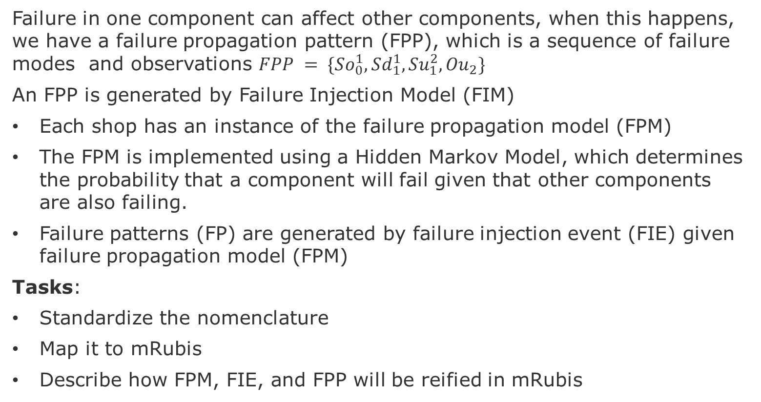
Definition Failure Propagation Pattern
Failure in one component can affect other components, when this happens, we have a failure propagation pattern (FPP), which is a sequence of failure modes and observations $FPP = \{{So}_{0}^{1},{Sd}_{1}^{1},{Su}_{1}^{2}, {Ou}_{2}\}$
An FPP is generated by Failure Injection Model (FIM)
Each shop has an instance of the failure propagation model (FPM)
The FPM is implemented using a Hidden Markov Model, which determines the probability that a component will fail given that other components are also failing.
Failure patterns (FP) are generated by failure injection event (FIE) given failure propagation model (FPM)
Tasks:
Standardize the nomenclature
Map it to mRubis
Describe how FPM, FIE, and FPP will be reified in mRubis

Slide 9
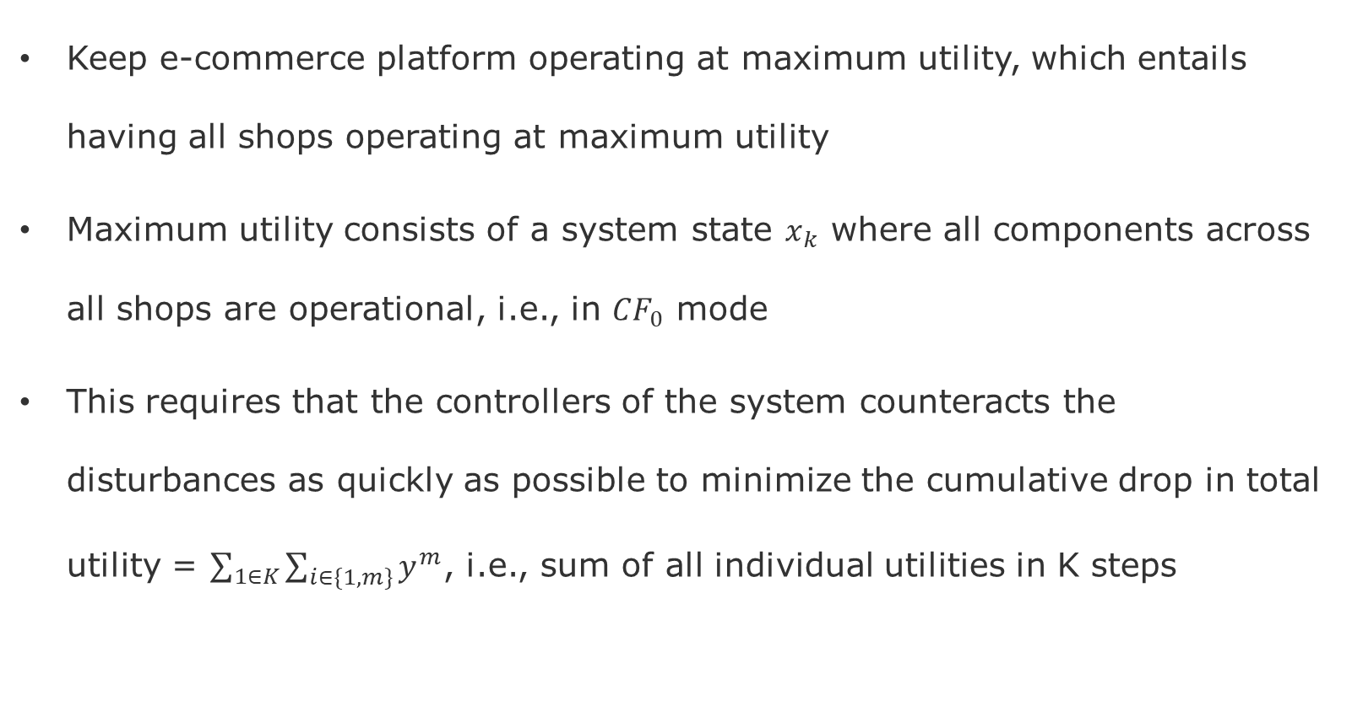
System Goal
Keep e-commerce platform operating at maximum utility, which entails having all shops operating at maximum utility
Maximum utility consists of a system state $x_{k}$ where all components across all shops are operational, i.e., in $CF_{0}$ mode
This requires that the controllers of the system counteracts the disturbances as quickly as possible to minimize the cumulative drop in total utility = $\sum_{1∈K}{\sum_{i∈\{1,m\}}{y^{m}}}$, i.e., sum of all individual utilities in K steps

Slide 10
Project Plan

Slide 11
Levels of Robustness
Level 1 – Robustness to Failure Propagation
Static Confounding (failure masking)
Dynamic Confounding (intermittent failure)
Level 2 - Robustness to Under-specification
OOD (Training does not cover the entire distribution space)
Rashamon sets with the HMMs (Failure Propagation Models are not Unique, Equivalence Classes, but some models present shortcuts, spurious correlations)
Level 3 - Robustness to Distribution Shifts
Concept drift (Changes in the System Utility – Nonstationarity)
Risk driven training for risk-averse evolution (safety)

Slide 12
Preliminary Work-Packages
1- Failure Propagation Model (Hidden Markov Model) - Florence
Study how to move the HMM implemented in the Python side to the Java side
2- Failure Injection Mechanism - Christopher
Study how to generate failure injects that reflect that failure propagation patterns
3- Reinforcement Learning-Part-1 Ulrike & Jonas
Study how to replace the Supervised Learning controller (Regression) with a Self-Supervised One (RL)
4- Multi-Agent RL: Study how to have two agents, each responsible for one shop.
5- Monitoring for Transfer Learning: Study how to measure the differences in policies across agents.
6- Robustness Tests: Study how to generate stress tests that show how policies are robust to perturbations, i.e., the agent is still able to fix the failures of its shop(s) with a minimal degradation in utility

Slide 13
Evaluation
1- Value-at-Risk* Trade-offs
Goal: Show different rates of synchronization among Agents:
1.1 excessive cost of training and redeployment
1.2 increase in the risk of under-performance
Cumulative performance
2- Convergence
Goal: Show that different strategies* to learn when to train and redeploy require:
2.1 more data to achieve an average value-at-risk
2.2 longer time to converge
*strategies could be different hyper-parameterizations of the algorithms
Look at visualization of RL outcomes - https://araffin.github.io/post/rliable/

Slide 14
End

Slide 15
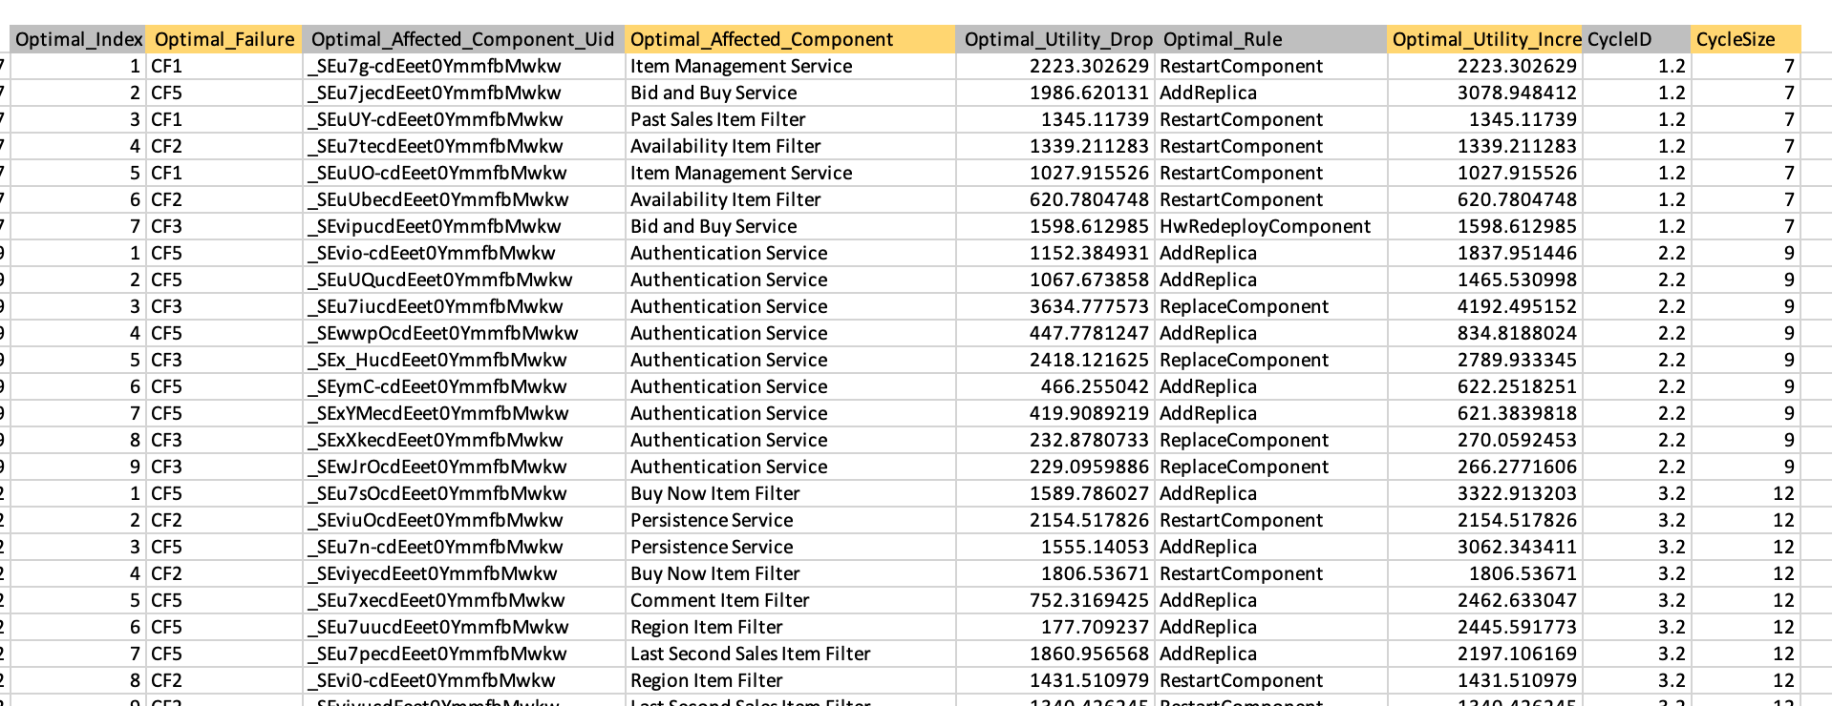
Data Used for the Implementation

Slide 16
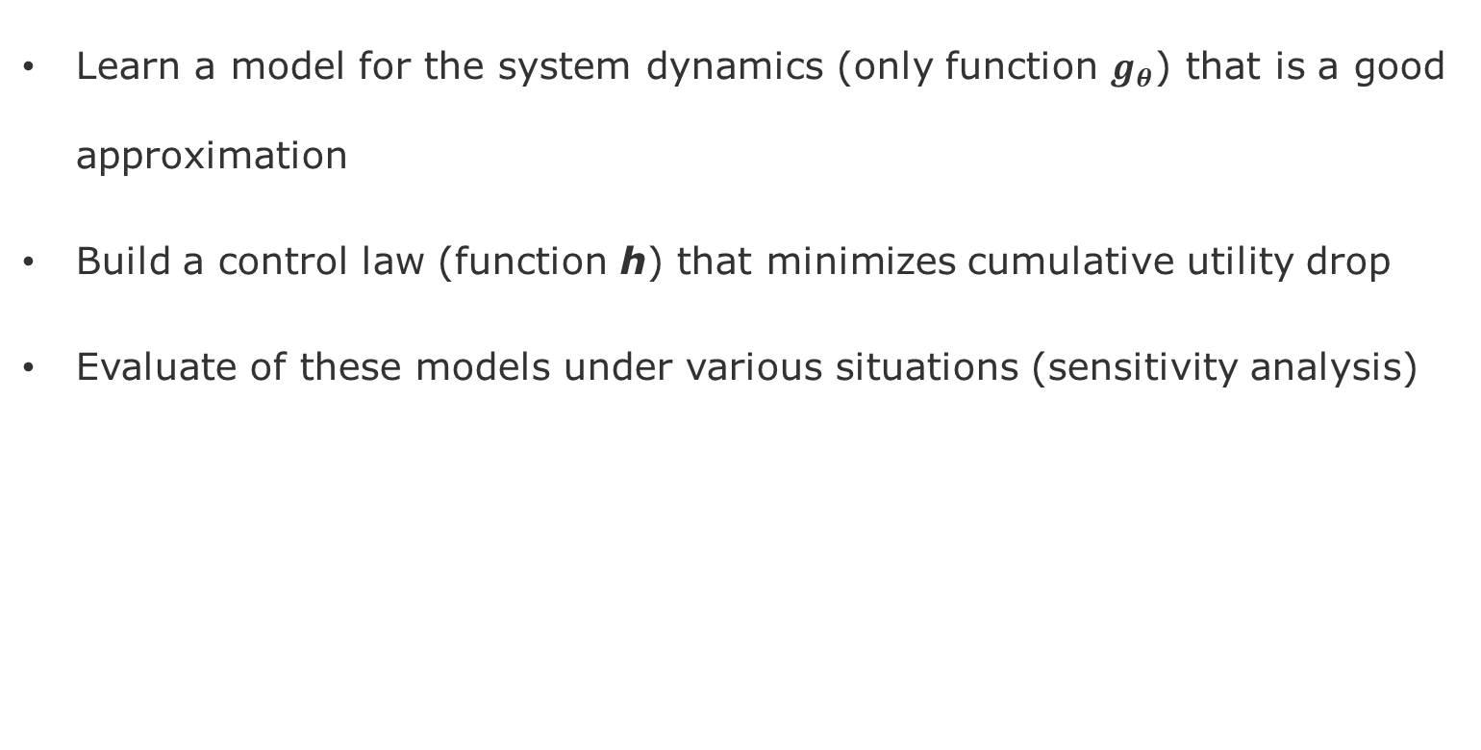
Deliverables
Learn a model for the system dynamics (only function $g_{θ}$) that is a good approximation
Build a control law (function h) that minimizes cumulative utility drop
Evaluate of these models under various situations (sensitivity analysis)

Slide 17
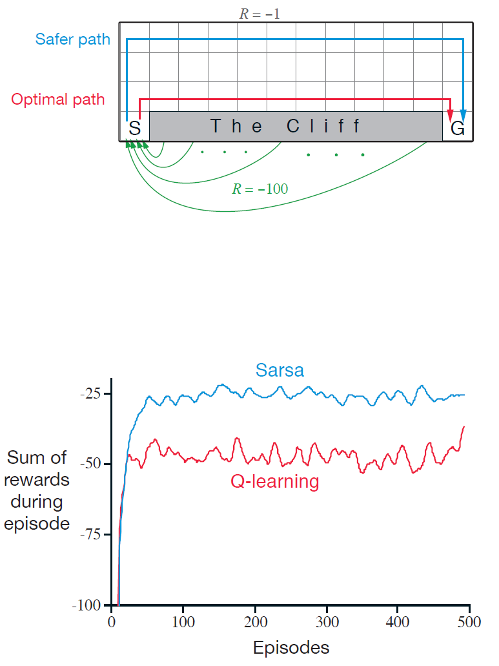
Trade-off between Sarsa and Q-Learning
Gridworld example from [Sutton & Barto 2018] page 132.
Goal: is to go from S to G avoiding the Cliff.

